Slide 1

Raw Housing Prices Analysis using Linear Regression
Project PPT

Slide 2

Data Set :- House Sales in King County, USA
The dataset is taken from the following website:- https://www.kaggle.com/datasets/harlfoxem/housesalesprediction
This dataset contains house sale prices for King County, which includes Seattle. It includes homes sold between May 2014 and May 2015.
It has 21 features and 21613 entries
The target variable is ‘Sale Price’
It's a great dataset for evaluating simple regression models.

Slide 3
OBJECTIVE
Dependent column – ‘Sale Price’
Independent column –
“ID”
Date House was Sold
No of Bedrooms
No of Bathrooms
Flat Area (in Sqft)
Lot Area (in Sqft)
No of Floors
Waterfront View
No of Times Visited
Lot Area after Renovation (in Sqft)”
Condition of the House
Overall Grade
Area of the House from Basement (in Sqft)
Basement Area (in Sqft)
Age of House (in Years)
Renovated Year
Zipcode
Latitude
Longitude
Living Area after Renovation (in Sqft)
Our objective is to predict the sale price of a house given all its features. Also we will try to find out which all features play a major role in determining the sale price.

Slide 4

A walk-through…
Data Pre-processing
Identifying and handling the missing values.
Model Building and Prediction
Splitting the dataset into train and test
Using Linear Regression from sklearn to fit the training data
Making predictions for the testing data
Finding out the score/accuracy of the model
Analyzing the features affecting the ‘Sale Price’
Using model coefficients and residuals to analyze the factors influencing the sale price of the house
Feature scaling
Encoding the categorical data.

Slide 5

DATA PRE-PROCESSING
Import desired libraries and dataset
Find out the descriptive statistics of our target variable and deal with the outliers
Treating missing values:-
Deleting the rows having null values in target column
Imputing the other null values (using median and mode)
Encode categorical variables using ANOVA, creation of dummy features and binning
Scale the dataset
Remove multicollinearity by analysing VIF i.e. variance inflation factor

Slide 6

MODEL BUILDING AND PREDICTION
Split the data into training data and testing data
Import Linear Regression class from sklearn.linear_model
Fit the training data to the model
Look at the regression coefficient
Make predictions for the training independent variables
Find out the score/accuracy of the model

Slide 7

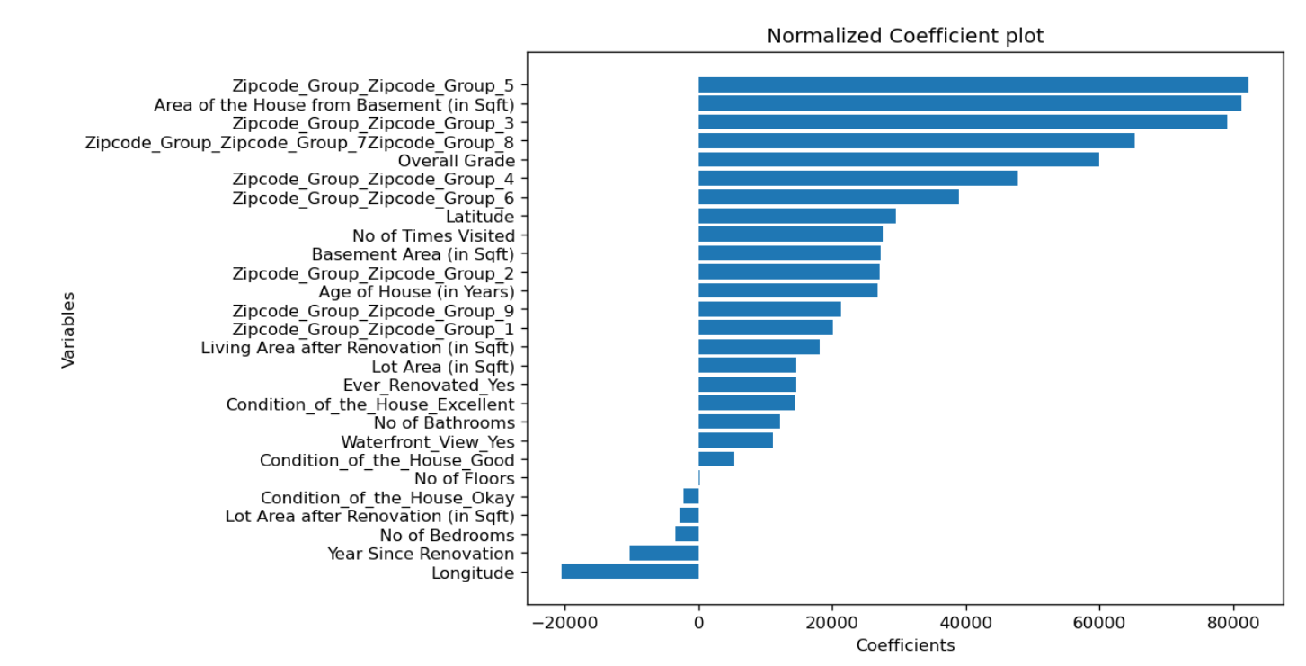
ANALYZING THE FEATURES AFFECTING THE ‘SALE PRICE’
Analyse the residuals through graphs to find out how many values are predicted correctly
Use model coefficients to determine how the features are influencing the “sale price”
Finally draw conclusions through bar chart

Slide 8

CONCLUSION FROM THE PROJECT
The location determined by zipcode plays a significant role in 'Sale Price' of the house
The Area of house from the basement has also played a major role in affecting the 'sale price' Overall Grade has also played quite significant role
The older house are more expensive than newer house which is counter intuitive.
Variables like 'Overall Grade', 'No of times visited', 'basement area', 'waterfront view' etc. has played a significant positive role in 'Sale Price
Customers often prefer the house that are recently renovated.
We see that Longitude has negative significance while the Latitude has positive significance.

Slide 9

THANK YOU!
Project by –
Nirav Pathak (1906258)
Saptarishi Kuila (1906275)
Shantanu Dubey(1906279)

